Slide 1
Introduction to Robotics
CSE 461
Lecture 13: Introduction to CNNs and Object Detection
Niloy Irtisam
Lecturer, Dept. of Computer Science and Engineering
Brac University

Slide 2
Last Class
What is Machine Learning
Neural Network

Slide 3
Mother Law of Machine Learning
w1 * x1 + w2 * x2 + w3 * x3 = y
x1, x2, ....., xn = Features
y = output/ target
w1, w2, ....., wn = Weights

Slide 4
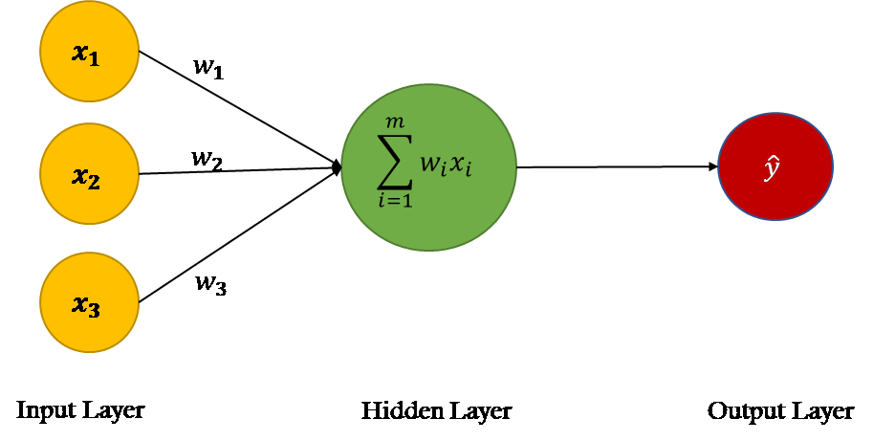
Neural Network
w1 * x1 + w2 * x2 + w3 * x3 = y

Slide 5
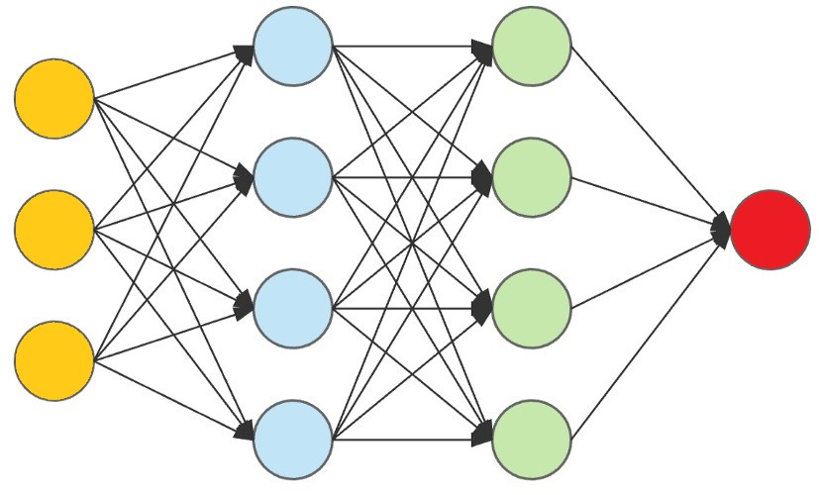
Neural Network
Predictions/
decisions
Features
Hidden Layers

Slide 6
Two types
Features are given (Handcrafted Features)
Raw Data is given not features

Slide 7
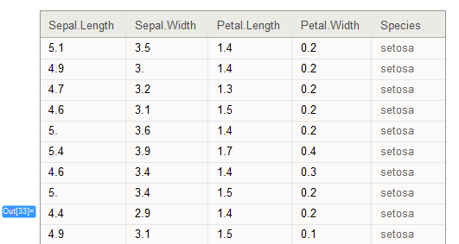

Slide 8
Some data column may not a good feature.
Some data column may need to be transformed.

Slide 9
Some data column may not a good feature.
Some data column may need to be transformed.
We can do it by our hand (Handcrafted)
Neural network does this automatically (Deep Learning)

Slide 10
Deep Learning
Deep learning is a type of machine learning based on artificial neural networks in which multiple layers of processing are used to extract progressively higher level features from data.

Slide 11
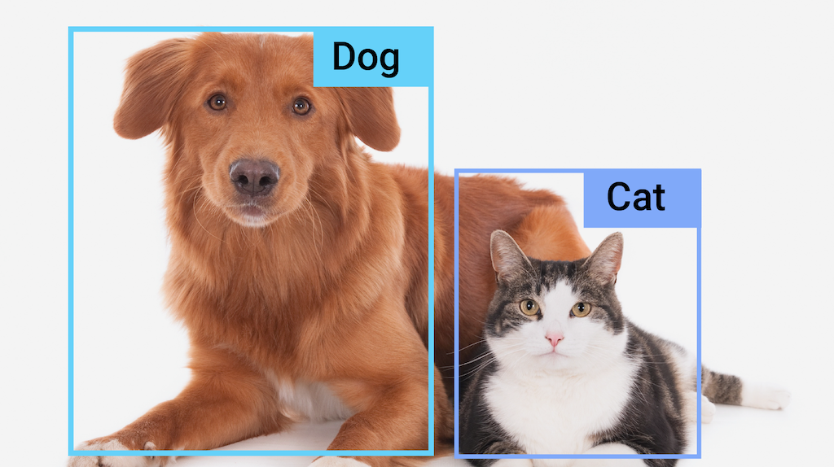
Let’s Do object detection

Slide 13
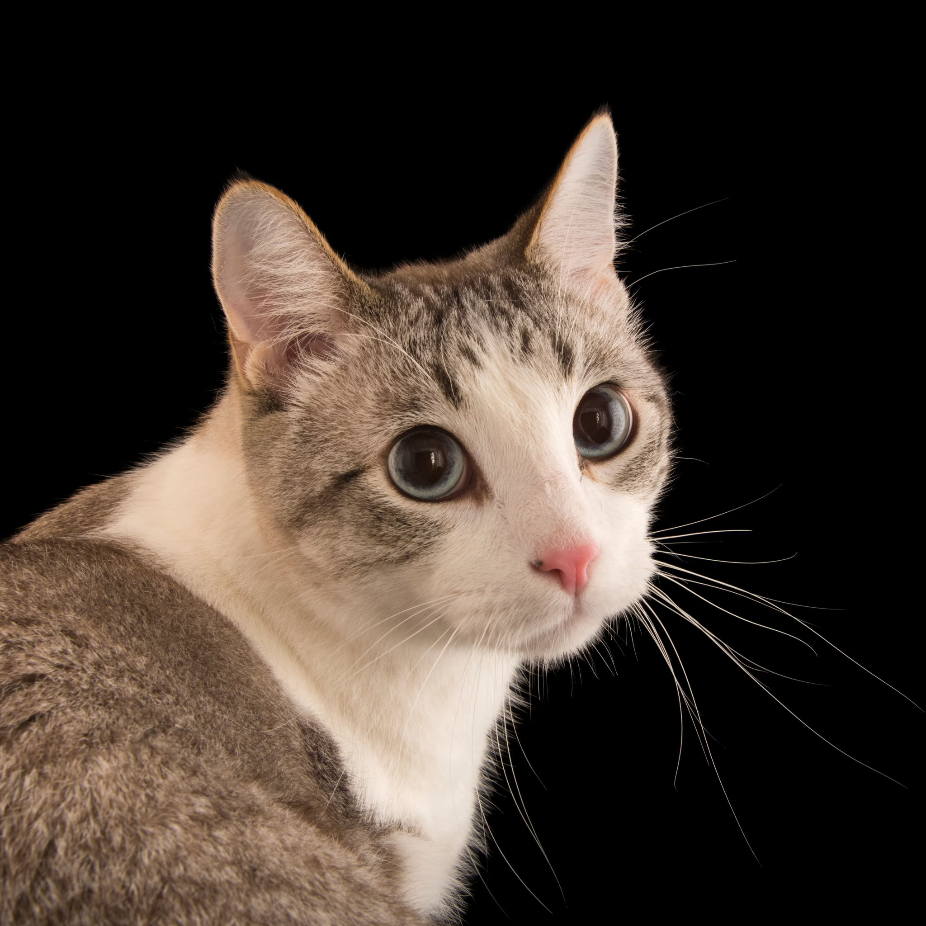

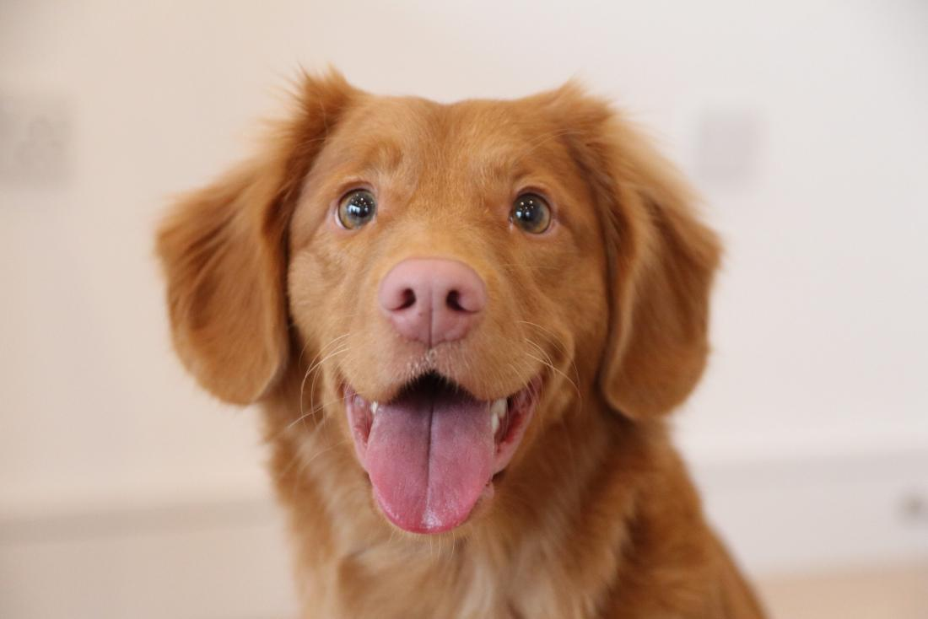
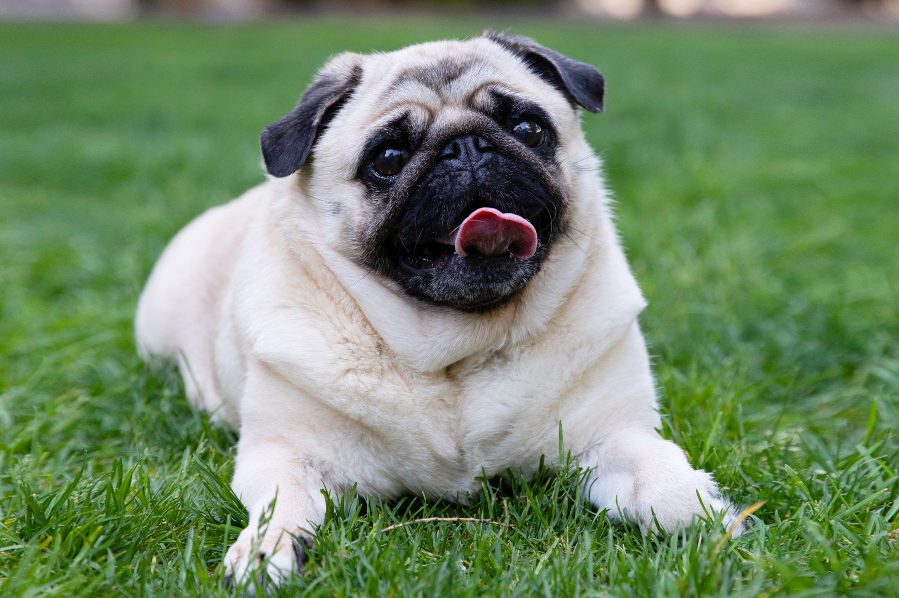
Cat
Cat
Dog
Dog
Features ??

Slide 14
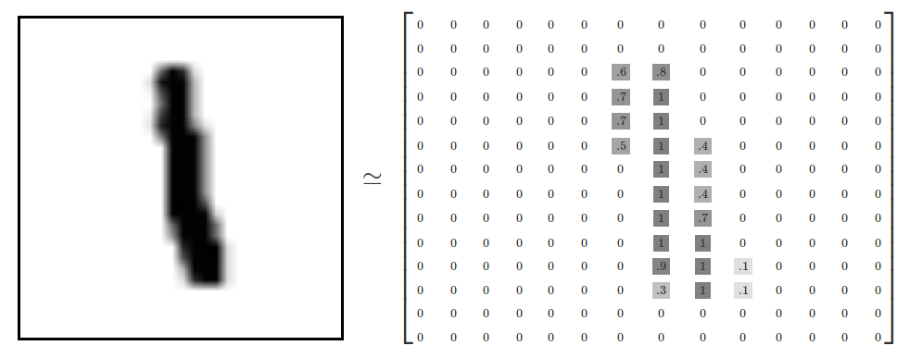

Slide 15
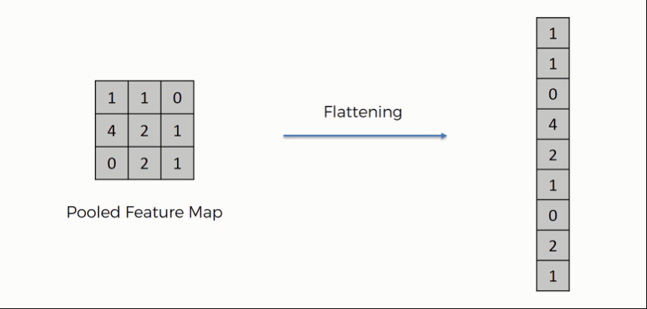
x1
x2
x3
.
.
.
.
.
.
.
.
.
x9
3x3
Image

Slide 16

Pixels as Features
x1
x2
x3
.
.
.
.
.
.
.
.
.
x9

Slide 17
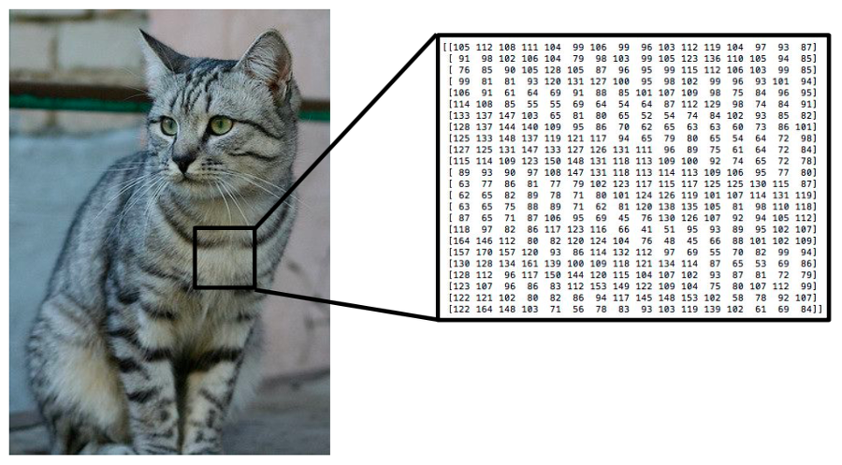
Pixels as Features

Slide 18
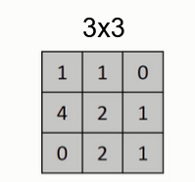
Problem with “Pixels as features”
3*3 = 9
12x12
12*12 = 144
680x420
680*420 = 285,600
680x420x3
680*420*3 = 856,800

Slide 19
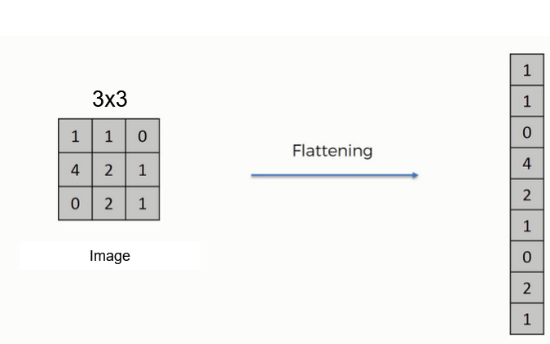
Problem with “Pixels as features”
No Structural Features

Slide 20
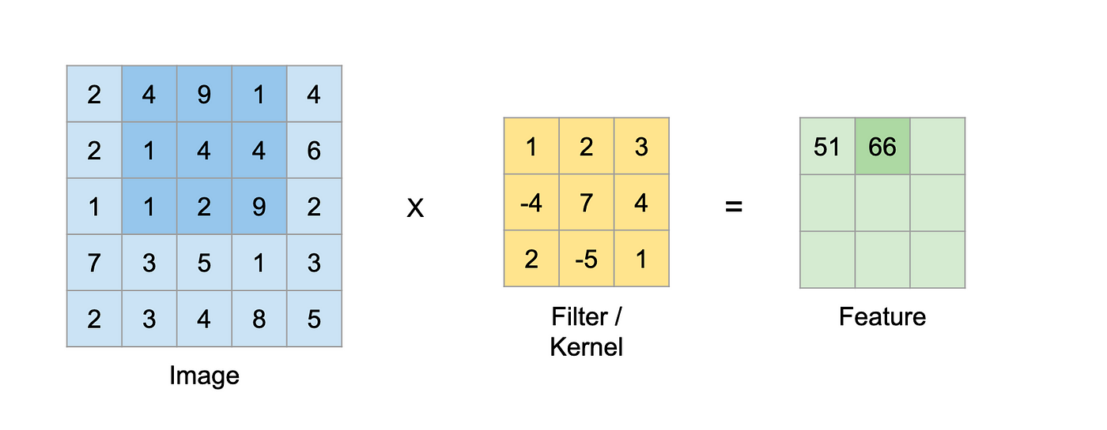

Slide 21
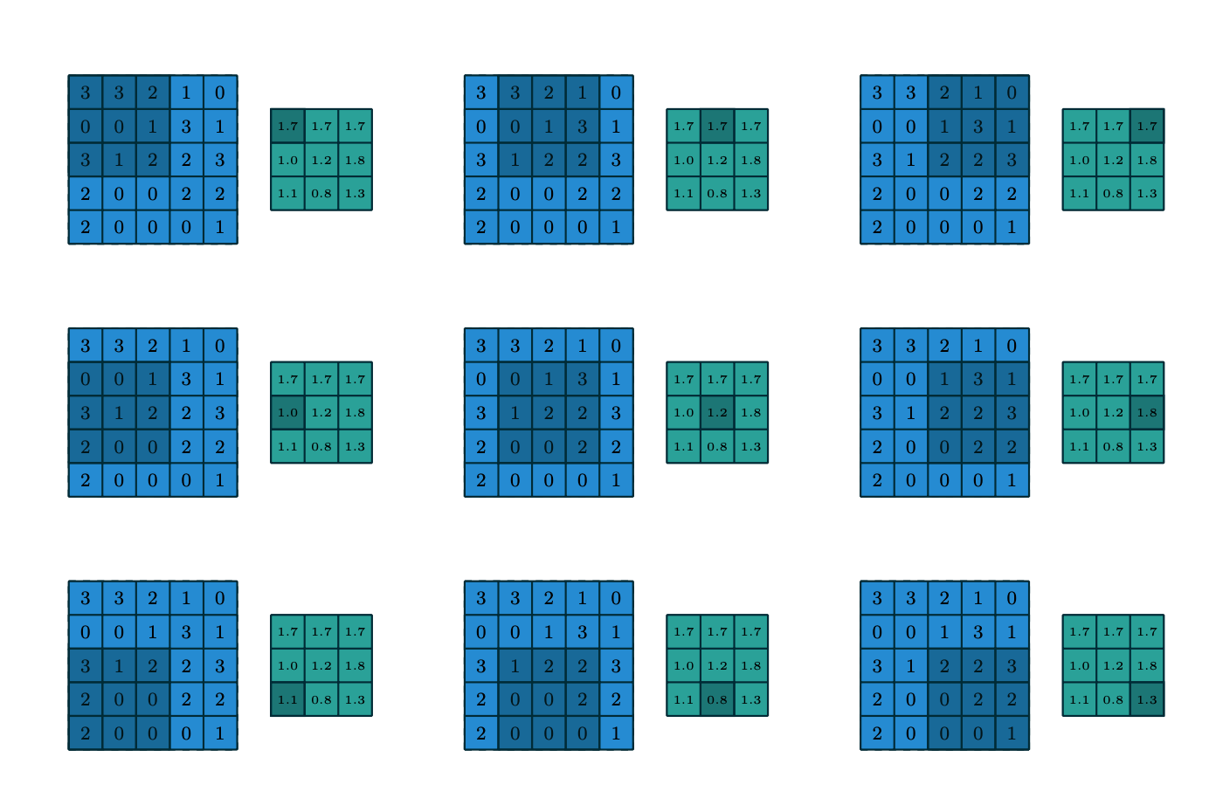
Convolution

Slide 22
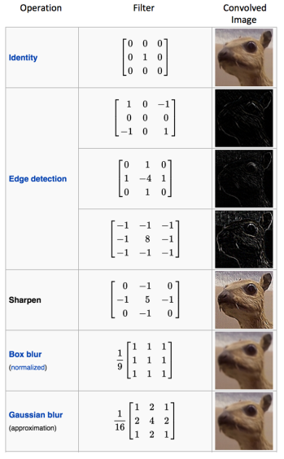
Kernels

Slide 23
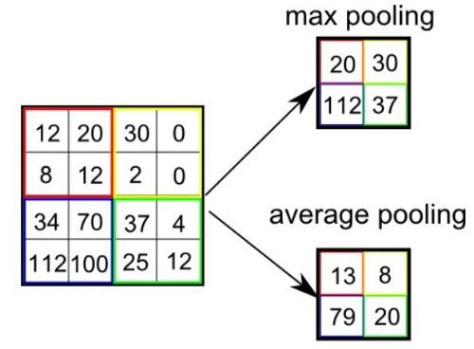
Pooling Layer
Used for reducing the number of parameters in case of large images
Also called Subsampling or Down sampling
Retains major information
Max pooling and average pooling are two types of pooling that are used

Slide 24
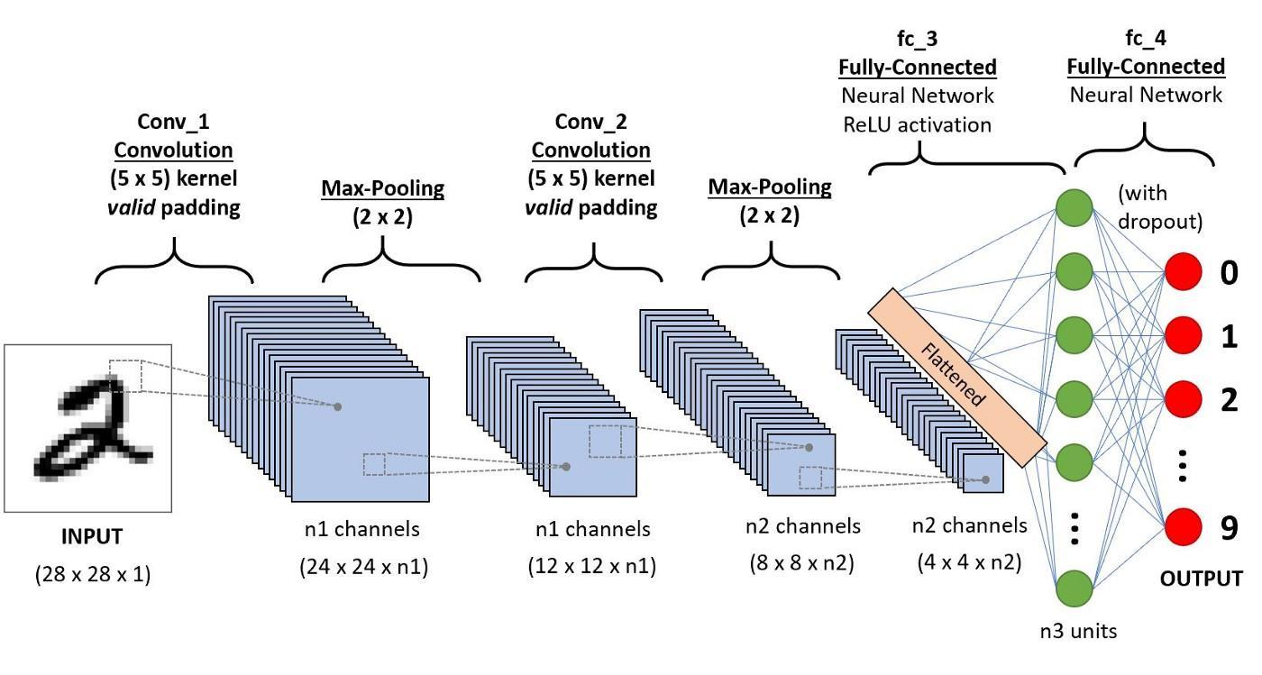
Architecture of CNNs

Slide 25
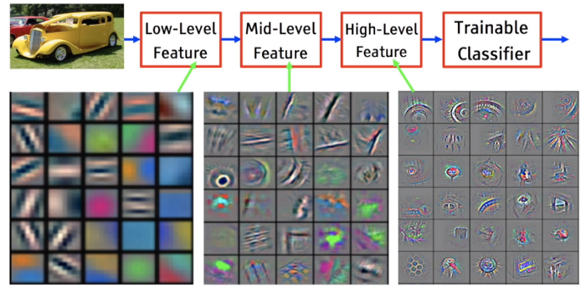
In the eyes of the CNN
https://miro.medium.com/max/2400/1*bIY_8FE7dJaGk1kjU7iVSg.png

Slide 26
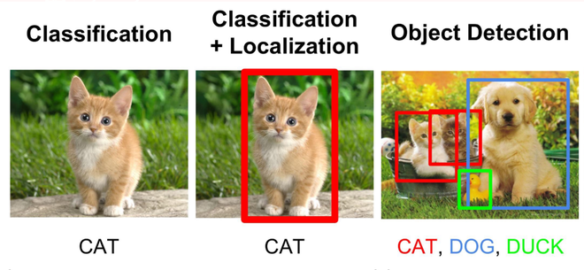

Slide 27
Some Popular Algorithms
Solved most of the challenges except for the speed:
Faster R-CNN
Single Shot MultiBox Detector (SSD)
Retina Net
YOLO algorithm was able to solve the object detection speed issue. Some of it’s features are:
Speed: This algorithm improves the speed of detection because it can predict objects in real-time.
High accuracy: provides accurate results with minimal background errors.
Learning capabilities: The algorithm has excellent learning capabilities.
It has multiple versions: YOLO V1, YOLO 9000, YOLO V3, YOLO V4
However, it has lower accuracy than state-of-the-art object detection algorithms
We will discuss YOLO in the upcoming slides

Slide 28
YOLO (You Only Look Once)
The YOLO framework takes the entire image in a single instance and predicts the bounding box coordinates and class probabilities for these boxes
It uses the following techniques:
Residual blocks
Bounding box regression
Intersection Over Union (IOU)

Slide 29
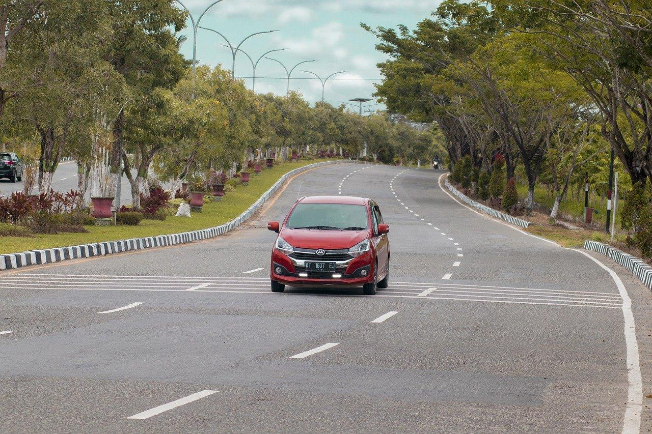
Basic Working Principle
1.Divide the image into S x S grids
2.Each grid predicts B bounding boxes
3.Return bounding boxes above
confidence threshold
Car:0.95
S=3
Grid
B=1
All other bounding boxes have confidence. Threshold below , suppose 0.90. So they were removed
If the center of a object falls into
a grid cell, that grid cell is responsible for
detecting that object

